Slide 1
AZ-100.1 Module 01: Managing Azure Subscriptions

Slide 2
Lesson 01: Overview of Azure Subscriptions

Slide 3
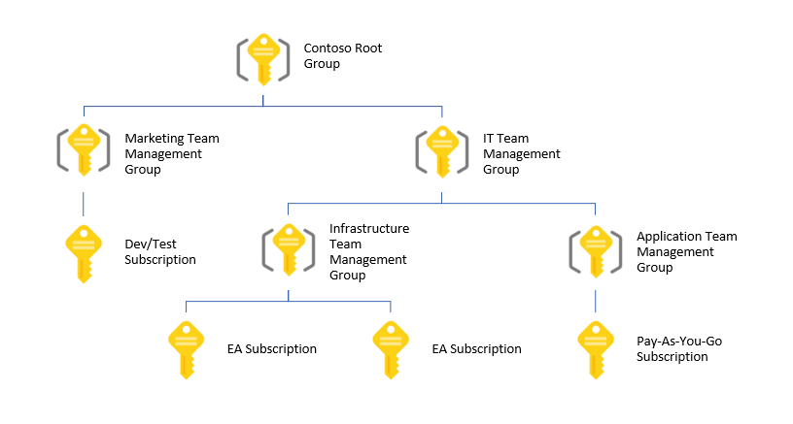
Management Groups
Provides a level of scope above subscriptions
Organizational alignment for your Azure subscriptions through custom hierarchies and grouping
Targeting of policies and spend budgets across subscriptions and inheritance down the hierarchies
Compliance and cost reporting by organization (business/teams)
Notes:
✔️ Management groups is a relatively new concept in Azure. Take time to review the reference links.
For more information, you can see:
Organize your resources with Azure management groups - https://docs.microsoft.com/en-us/azure/azure-resource-manager/management-groups-overview
Create management groups for resource organization and management - https://docs.microsoft.com/en-us/azure/azure-resource-manager/management-groups-create?toc=/azure/billing/TOC.json

Slide 4
Azure Subscriptions and Accounts
A subscription is a logical unit of Azure services that is linked to an Azure account
An account is an identity in Azure AD or in a directory that is trusted by Azure AD
Users,
groups, and service principles
Azure Active Directory
Authentication
& Authorization
Azure resources in resource groups
Azure Subscription(s)
Notes:
✔️ Do you know how many subscriptions your organization has? Do you know how resources are organized into resource groups?

Slide 5

Getting an Azure Subscription
Enterprise Agreement
Reseller - Open Licensing program
Microsoft partner
Free trial account
Notes:
✔️ Which subscription model are you most interested in?
For more information, you can see:
Solution providers - https://www.microsoft.com/en-us/solution-providers/home

Slide 6
Video: Controlling Access to Subscriptions
Administrative Role | Limit | Summary
Account Administrator | 1 per Azure account | Authorized to access the Account Center (create subscriptions, cancel subscriptions, change billing for a subscription, change Service Administrator, and more)
Service Administrator | 1 per Azure subscription | Authorized to access the Azure Management Portal for all subscriptions in the account. By default, same as the Account Administrator when a subscription is created.
Co-administrator | 200 per subscription | Same as the Service Administrator, but can’t change the association of subscriptions to Azure directories.

Slide 7
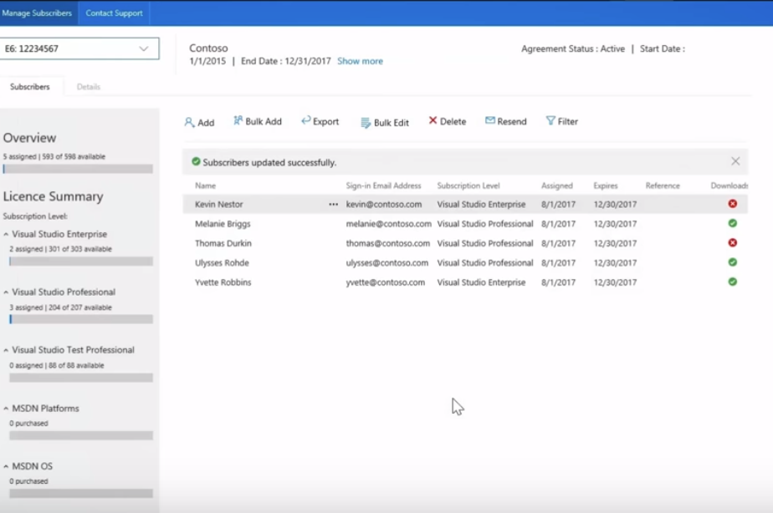
Video: Visual Studio Administration Portal
Notes:
For more information, you can see:
https://visualstudio.microsoft.com/subscriptions-administration/

Slide 8
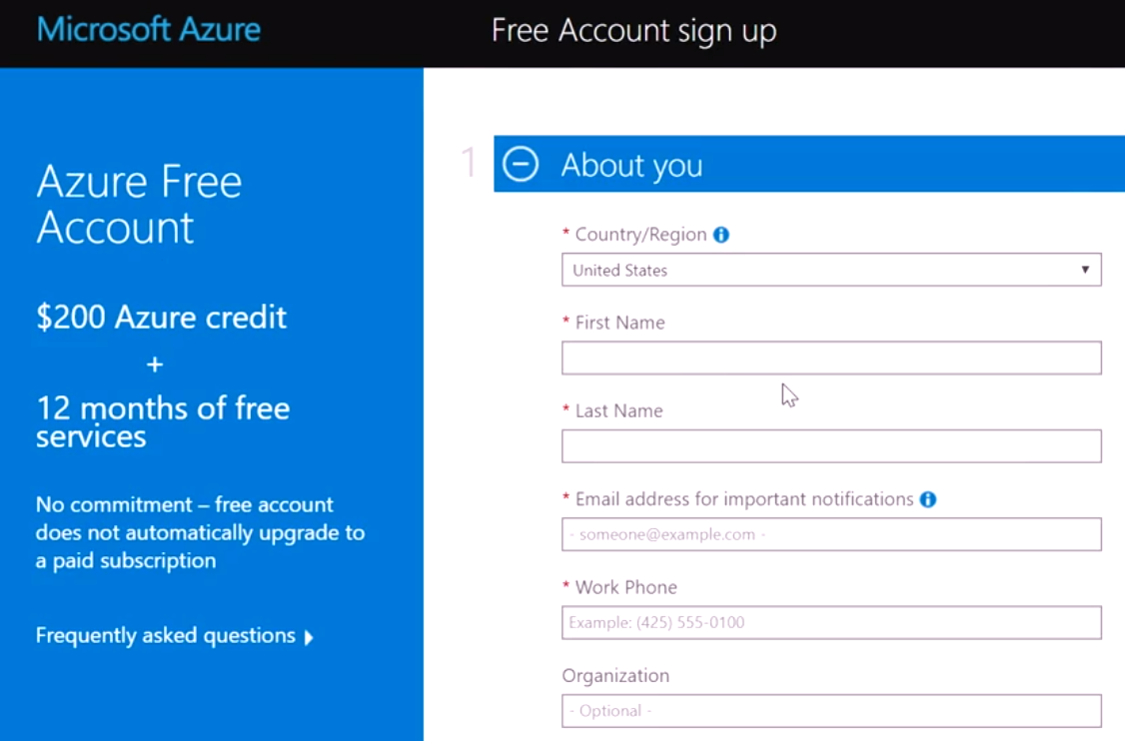
Video: Azure Free Account

Slide 9
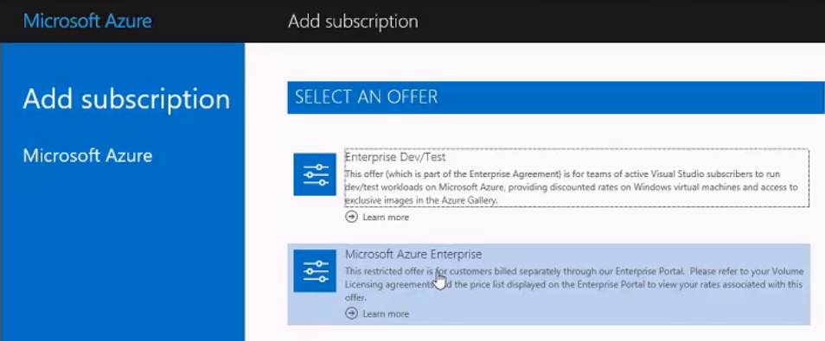
Video: EA Dev/Test Subscriptions

Slide 10
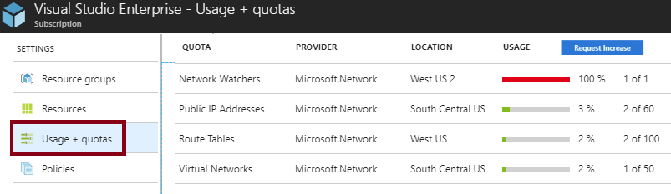
Check Resource Usage
All resources have a maximum limit listed in Azure limits
Helpful to track current usage, and plan for future use
You can request an increase
Notes:
✔You can also check your resource limits with PowerShell and the CLI. Learn more at the reference link. Be sure to review the limits page.
For more information, you can see:
Check resource usage against limits - https://docs.microsoft.com/en-us/azure/networking/check-usage-against-limits

Slide 11
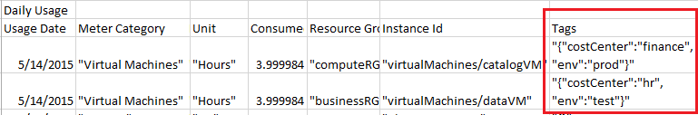
Tags
Tags logically organize your resources
Tags consist of a name and value
Useful especially in billing
Notes:
✔️ If you must create a lot of tags you will want to do that programmatically. You can use PowerShell or the CLI. Learn more at the reference links.
For more information, you can see:
Use tags to organize your Azure resources - https://docs.microsoft.com/en-us/azure/azure-resource-manager/resource-group-using-tags
PowerShell (Tagging) - https://docs.microsoft.com/en-us/azure/azure-resource-manager/resource-group-using-tags#powershell
CLI (Tagging) - https://docs.microsoft.com/en-us/azure/azure-resource-manager/resource-group-using-tags#azure-cli

Slide 12

Video: Enforcing Tags with Policy
Resource Group
Policy Script
Yes
Tag?
Create Resource
No
Request a Tag

Slide 13
Lesson 02: Billing

Slide 14
Available Roles
Application Administrator
Application Developer
Billing Administrator
Global Administrator
Password Administrator / Help Desk Administrator
Security Administrator
User Account Administrator
Notes:
✔️ Account Administrators using a Microsoft account must log in every 2 years (or more frequently) to keep the account active. Inactive accounts are cancelled, and the related subscriptions removed. There are no login requirements if using a work or school account. Take a few minutes to look through the list of available roles at the reference link.
For more information, you can see:
Assigning administrator roles in Azure Active Directory - https://docs.microsoft.com/en-us/azure/active-directory/users-groups-roles/directory-assign-admin-roles

Slide 15
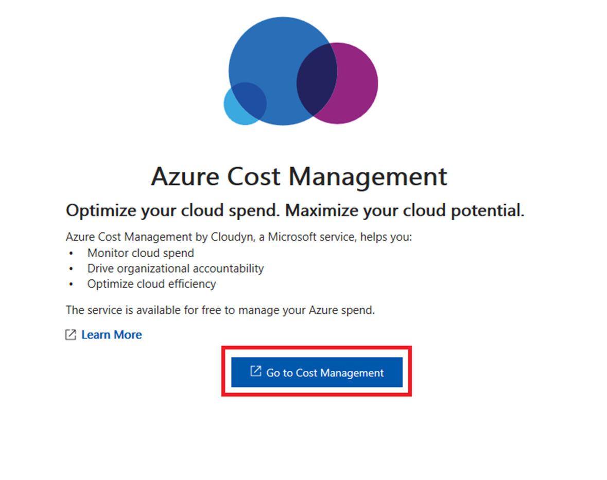
Billing
Get Resource usage data
Predict future costs
Set up billing alerts
Notes:
For more information, you can see:
Azure Cost Management Documentation - https://docs.microsoft.com/en-us/azure/cost-management/

Slide 16
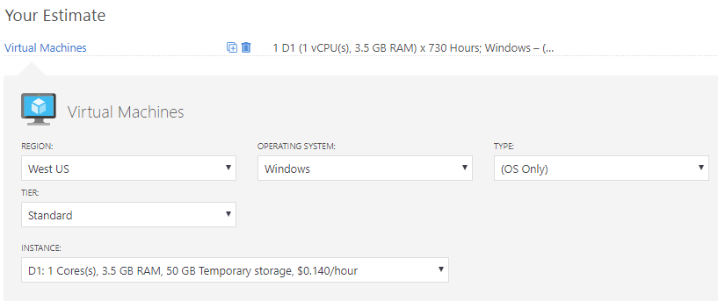
Pricing Calculator
Estimates in compute, networking, storage, web, and databases
Prices are estimates and are not intended as actual price quotes
Notes:
✔️ Take a few minutes to access the Pricing Calculator and try a few scenarios.
For more information, you can see:
Pricing Calculator - https://azure.microsoft.com/en-us/pricing/calculator/

Slide 17
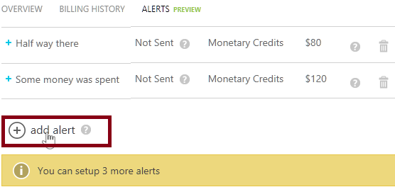
Billing Alert Service
Available to Account Administrators
Monitor and manage billing activity for your Azure accounts
Five billing alerts per subscription, two email recipients for each alert
Notes:
✔ EA subscriptions are not supported by this service, instead EA customers can get alerts for each department under an enrollment by setting spending quotas.
For more information, you can see:
Set up billing or credit alerts for your Microsoft Azure subscriptions - https://docs.microsoft.com/en-us/azure/billing/billing-set-up-alerts

Slide 18
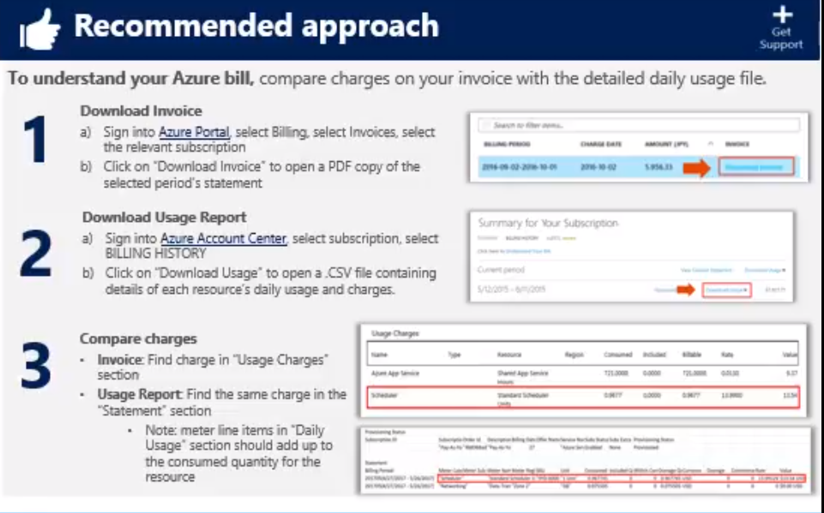
Video: Understand Your Bill

Slide 19
Additional Practice: View Your Bill
Download or view your Azure billing invoice and daily usage data
Get your invoice in email
Download an invoice from the Azure portal
Download usage from the Account Center
Notes:
✔️ An invoice is only generated when you owe money. If you have a monthly credit amount or if you have a Free Trial, then you may not have an invoice.
For more information, you can see:
Understand terms on your Microsoft Azure invoice - https://docs.microsoft.com/en-us/azure/billing/billing-understand-your-invoice
Understand terms on your Microsoft Azure detailed usage charges - https://docs.microsoft.com/en-us/azure/billing/billing-understand-your-invoice#detailed-terms-and-descriptions-of-your-invoice

Slide 20
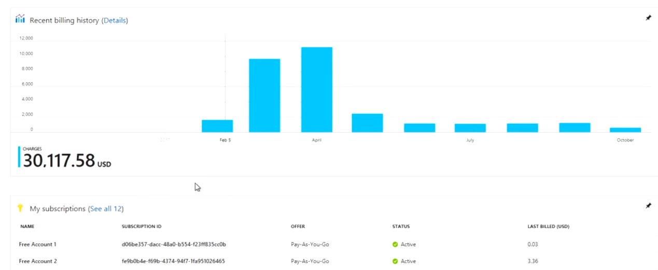
Video: Azure Billing

Slide 21
Lesson 03: Azure Policy

Slide 22
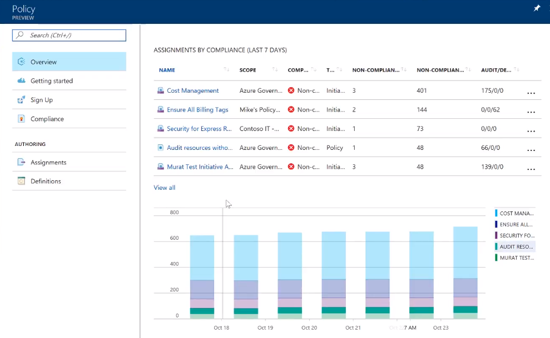
Video: Azure Policy

Slide 23
Azure Policy
Azure Policy is a service in Azure that you use to create, assign and, manage policies
Azure Policy runs evaluations and scans for non-compliant resources
Advantages:
Enforcement and compliance
Apply policies at scale
Remediation
Notes:
For more information, you can see:
Azure Policy Documentation - https://docs.microsoft.com/azure/azure-policy/

Slide 24
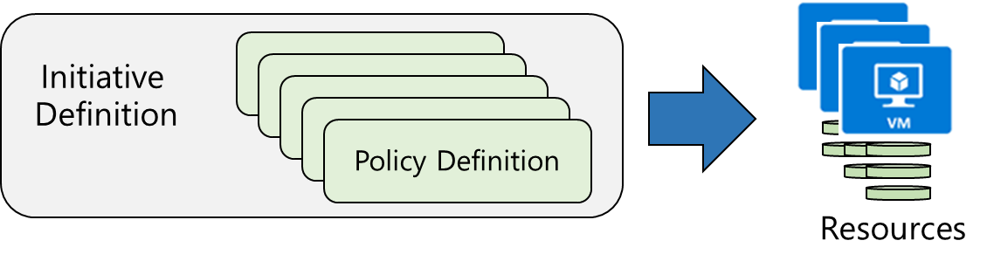
Implementing Azure Policies
Browse Policy Definitions
Create Initiative Definitions
Scope the Initiative Definition
View Policy evaluation results
Notes:
✔ Even if you have only a few Policy Definitions, we recommend creating an Initiative Definition. The next slides are the four steps on the slide.

Slide 25
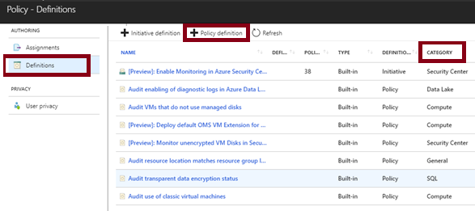
Browse Policy Definitions
Many policy definitions are available
You can import policies from GitHub
Policy Definitions have a specific JSON format
Notes:
✔️ Policy Definitions have a specific JSON format. As an Azure Administrator you will not need to create files in this format, but you may want to take a look so you are familiar. Review the available definitions in the portal and in GitHub.
For more information, you can see:
Policy Definition -
https://docs.microsoft.com/en-us/azure/azure-policy/azure-policy-introduction#policy-definition

Slide 26
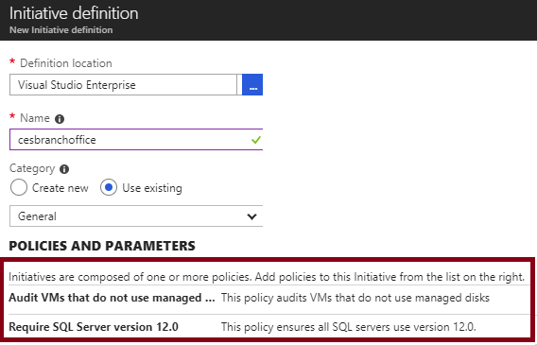
Create Initiative Definitions
Group policy definitions
Include one or more policies
Requires planning
Notes:
✔️ Can you see how this will require some planning to organize your policies?
For more information, you can see:
Initiative definition - https://docs.microsoft.com/en-us/azure/azure-policy/azure-policy-introduction#initiative-definition

Slide 27
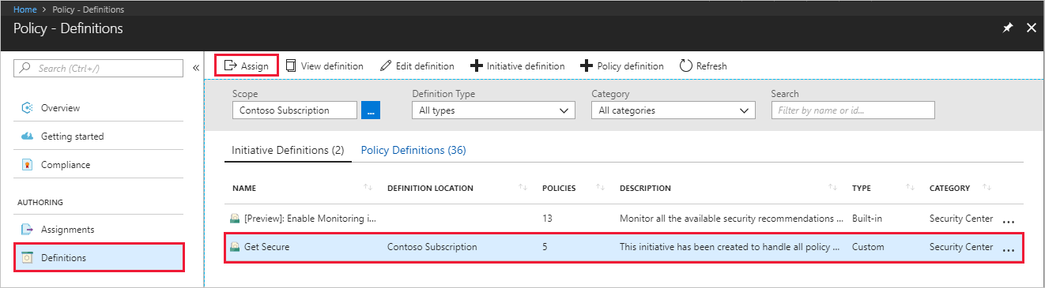
Scope the Initiative Definition
Assign the definition to a scope
The scope enforces the policy
Select the subscription, and optionally the resource group
Notes:
✔️ Currently, an Initiative Definition can have up to 100 policies.
For more information, you can see:
Initiative assignment - https://docs.microsoft.com/en-us/azure/azure-policy/azure-policy-introduction#initiative-assignment
Recommendations for managing policies - https://docs.microsoft.com/en-us/azure/azure-policy/azure-policy-introduction#recommendations-for-managing-policies

Slide 28
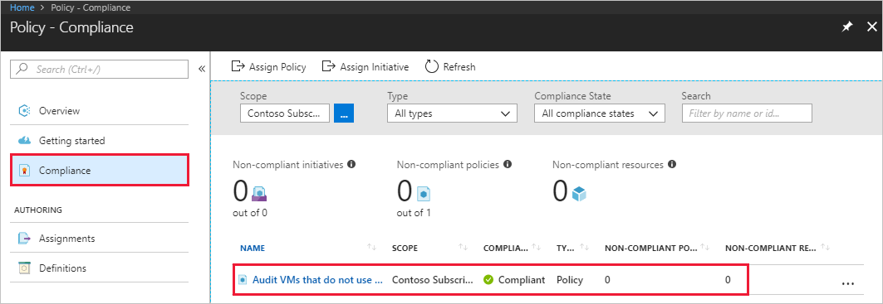
Determine Compliance
Non-compliant initiatives
Non-compliant policies
Non-compliant resources
Notes:
✔️ Policy evaluation happens about once an hour, which means that if you make changes to your policy definition and create a policy assignment then it will be re-evaluated over your resources within the hour.
For more information, you can see:
Identify non-compliant resources - https://docs.microsoft.com/en-us/azure/azure-policy/assign-policy-definition#identify-non-compliant-resources

Slide 29
Additional Practice: Create and Manage Policies
Download or view your Azure billing invoice and daily usage data
Get your invoice in email
Download an invoice from the Azure portal
Download usage from the Account Center
Notes:
✔️ You can also create a policy with PowerShell or the CLI.
For more information, you can see:
Quickstart: Create a policy assignment to identify non-compliant resources using the Azure RM PowerShell module - https://docs.microsoft.com/en-us/azure/azure-policy/assign-policy-definition-ps
Create a policy assignment to identify non-compliant resources in your Azure environment with the Azure CLI - https://docs.microsoft.com/en-us/azure/azure-policy/assign-policy-definition-cli

Slide 30
Module 1: Review Questions
You manage several Azure subscriptions for an organization. You need to be able to efficiently manage the subscriptions. What are management groups? What advantages does management groups provide? How could you use management groups in this situation?
You manage Azure resources for an organization. Many distinct groups within the organization use Azure resources. You need to organize the resources based on which group is using the resources. How can you use tagging to help organize your resources? What are the benefits and limitations of tagging?
You are managing Azure resources for an organization. You need to ensure that all resources follow corporate standards and service level agreements (SLA). You have decided to use Azure policies. What are Azure policies and what are the main advantages to using them?
Notes:
Q1 Answer: If your organization has several subscriptions, you may need a way to efficiently manage access, policies, and compliance for those subscriptions. Azure management groups give a level of scope above subscriptions. You organize subscriptions into containers called "management groups" and apply your governance conditions to the management groups. Management groups enable: Organizational alignment for your Azure subscriptions through custom hierarchies and grouping.
Targeting of policies and spend budgets across subscriptions and inheritance down the hierarchies.
Compliance and cost reporting by organization (business/teams).
Q2 Answer: You can apply tags to your Azure resources to logically organize them by categories. Each tag consists of a name and a value. For example, you can apply the name “Environment” and the value “Production” or “Development” to your resources. After creating your tags, you associate them with the proper resources.
Benefits. With tags in place, you can retrieve all the resources in your subscription with that tag name and value. This means, you can retrieve related resources from different resource groups. One of the best uses of tags is to group billing data. When you download the usage CSV for services, the tags appear in the Tags column. For example, you could group virtual machines by cost center and production environment.
Limitations. Each resource or resource group can have a maximum of 15 tag name/value pairs. Tags applied to the resource group are not inherited by the resources in that resource group.
Q3 Answer: Azure Policy is a service in Azure that you use to create, assign and, manage policies. These policies enforce different rules over your resources, so those resources stay compliant with your corporate standards and service level agreements.
The main advantages of Azure policy are in the areas of enforcement and compliance, scaling, and remediation.
Enforcement and compliance. Turn on built-in policies or build custom ones for all resource types. Real time policy evaluation and enforcement. Periodic and on-demand compliance evaluation.
Apply policies at scale. Apply policies to a Management Group with control across your entire organization. Apply multiple policies and aggregate policy states with policy initiative. Define an exclusion scope.
Remediation. Real time remediation, and remediation on existing resources (coming soon).

